Slide 1


p
Unveiling the Power of AWS
Detective and Detective
Guard
This presentation explores the essential features and benefits of AWS
Detective and its powerful extension, Detective Guard, providing a
comprehensive understanding of how they enhance security and streamline
threat detection.
Presentation By
Dhanush E
reencoded.png

Slide 2

What is AWS Detective?
Proactive Security Posture
Threat Detection and Analysis
AWS Detective acts as a proactive security posture tool,
automatically analyzing your AWS environment for suspicious
activities and potential security risks.
It identifies security issues and suspicious behavior in your
AWS environment by analyzing and correlating security data
from various services, like VPC flow logs, CloudTrail logs, and
GuardDuty findings.
p
reencoded.png

Slide 3
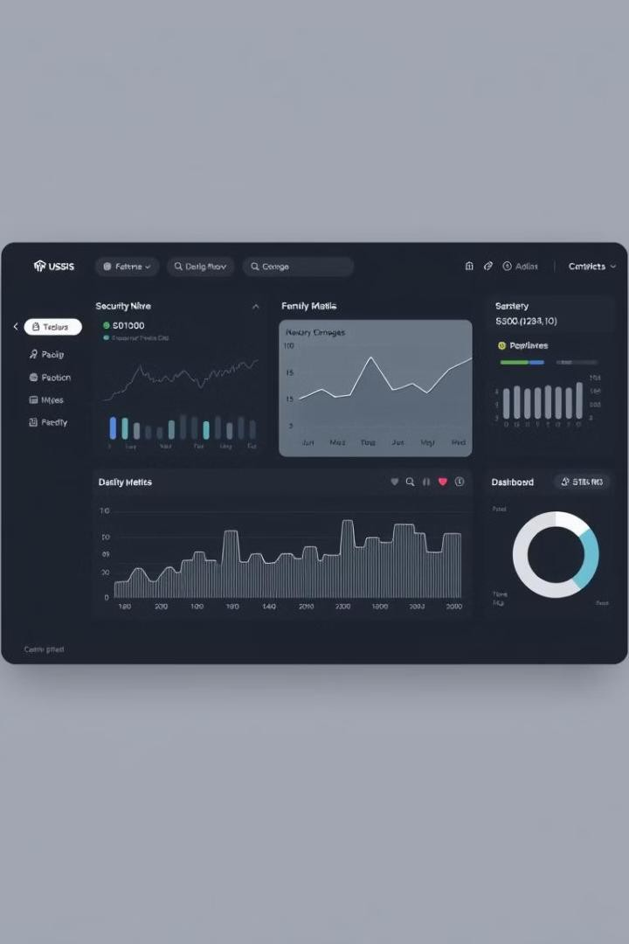
Key Features and Benefits of
AWS Detective
Automated Analysis
It continuously analyzes your
environment, eliminating manual
data analysis and saving valuable
time for security teams.
Security Insights
It provides actionable insights
and detailed reports, helping you
understand the root cause of
security issues and implement
effective mitigation strategies.
Reduced Attack Surface
By identifying potential security threats, you can proactively reduce your
attack surface and strengthen the security posture of your AWS
environment.
p
reencoded.png

Slide 4
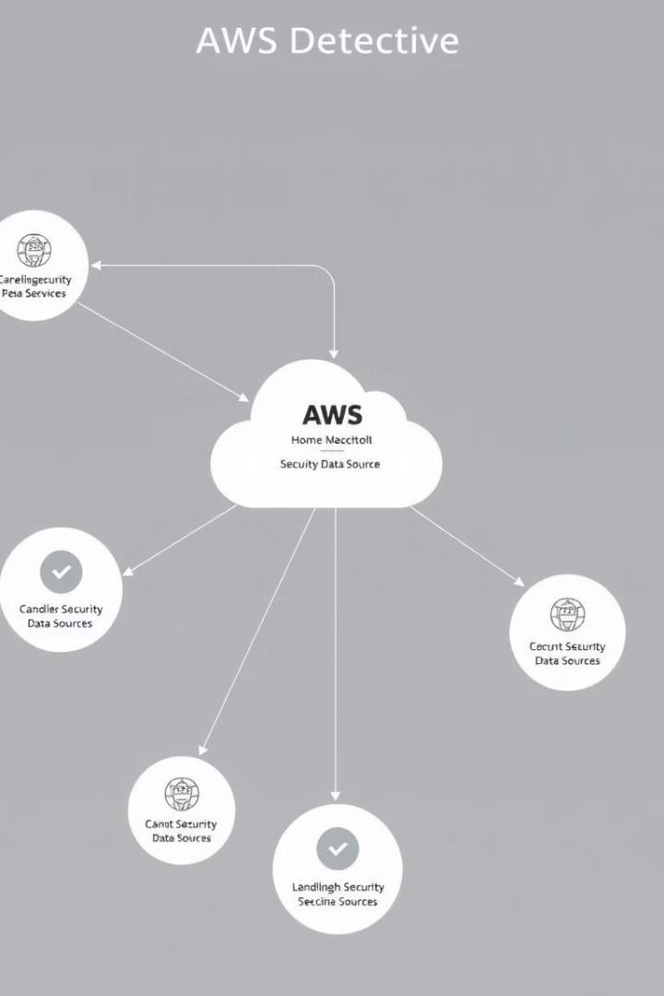
p
How
AWS Detective Works
1
AWS Detective collects security data from various services
like VPC Flow Logs, CloudTrail logs, and GuardDuty findings.
2
This data is then analyzed using machine learning
algorithms to identify potential security threats and suspicious activities.
3
AWS Detective then generates reports and alerts that
provide insights into security issues and actionable recommendations.
reencoded.png

Slide 5




Enhancing
Detective
Security with AWS
Improved Visibility
Detective provides a unified view of security data, enabling you to quickly identify potential security threats.
Proactive Threat Detection
It enables you to proactively identify and address security issues before they can escalate into major incidents.
Faster Incident Response
The actionable insights and alerts
enable faster and more efficient
incident response times.
p
reencoded.png

Slide 6



Introducing
AWS
Detective Guard
Enhanced Threat Detection
Detective Guard extends AWS Detective's capabilities by providing automated
threat detection for common security misconfigurations and vulnerabilities.
1
Proactive Security Posture
It proactively identifies and alerts you to potential security risks, allowing you to address them before they can be exploited.
2
Enhanced Compliance
It helps you achieve and maintain compliance with industry
standards and regulations, like CIS benchmarks and HIPAA.
3
p
reencoded.png

Slide 7


Integrating AWS Detective
and
Detective Guard
Data Integration
Detective Guard leverages the security data collected by AWS Detective to enhance its threat detection capabilities.
Enhanced Alerts
It generates more specific and actionable alerts, providing detailed information on detected security risks.
Automated Remediation
It allows you to automate the remediation of security issues,
reducing the workload and improving security posture.
p
reencoded.png

Slide 8

p
Use Cases for AWS
Guard
1
Cloud Security Posture
Detective
2
Compliance Auditing
Detective Guard can help you identify and
remediate misconfigurations that could expose your cloud infrastructure to attacks.
It assists in achieving and maintaining
compliance with industry standards and regulations like CIS benchmarks.
3
Threat Hunting
Detective Guard provides automated threat hunting capabilities, enabling you to proactively identify and address security threats.
reencoded.png

Slide 9
Best Practices for Implementing AWS Detective
and
Detective Guard
Enable AWS Detective
Enable AWS Detective for your AWS environment to start automatically analyzing your security data.
1
Configure Detective Guard
Configure Detective Guard to monitor your environment for common security misconfigurations and vulnerabilities.
2
Review Alerts
Regularly review the alerts generated by AWS Detective and
Detective Guard to address any security issues.
3
p
reencoded.png

Slide 10


Conclusion and Key
Takeaways
AWS Detective and Detective Guard are essential tools for enhancing
security posture in the cloud. By leveraging these services, organizations can
proactively detect and respond to threats, improve compliance, and ensure
the integrity of their AWS environment.
p
reencoded.png

Slide 11

What is
Amazon
Security
Lake?
Amazon Security Lake is a centralized data lake service
that simplifies security data management and analysis.
It allows you to collect, store, and analyze security data
from various sources in a single, unified platform. You can
easily query and visualize this data for proactive threat
detection and incident response.
p
reencoded.png

Slide 12

p
Key
Features
and
Benefits
Centralized Data
Storage
Consolidate security data
from various sources into a
single repository for efficient
analysis.
Schema-on-Read
Provides flexibility to easily
access and analyze data
without predefined
schemas.
Data Normalization
Standardizes data formats to
simplify analysis and cross-
source correlation.
Scalability and Cost-
Effectiveness
Provides pay-as-you-go
pricing and scales
automatically to
accommodate data growth.
reencoded.png

Slide 13
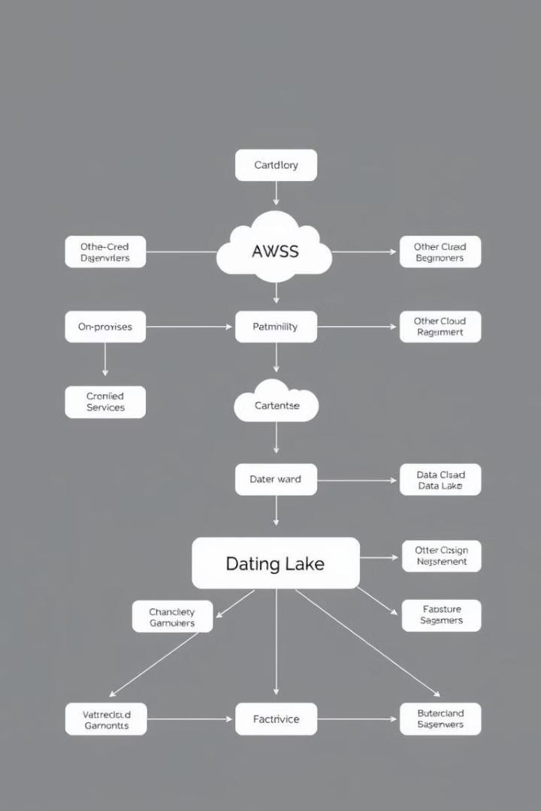
p
Data
Sources
and
Normalization
AWS Services
Collect security data from
services like CloudTrail,
GuardDuty, and VPC Flow
Logs.
On-Premise Systems
Integrate with your existing security tools and infrastructure.
Third-Party Services
Connect with security solutions from other cloud providers and vendors.
Data Normalization
Standardizes data formats
and schemas to enable easier analysis and correlation.
reencoded.png

Slide 14





Use
Cases
and
Capabilities
Threat Detection
Identify suspicious activities
and potential threats across
your environment.
Compliance Auditing
Demonstrate compliance
with security standards and
regulations.
Incident Response
Investigate security
incidents and quickly
identify root causes.
Security Forensics
Collect and analyze forensic
evidence for incident
investigation.
p
reencoded.png

Slide 15
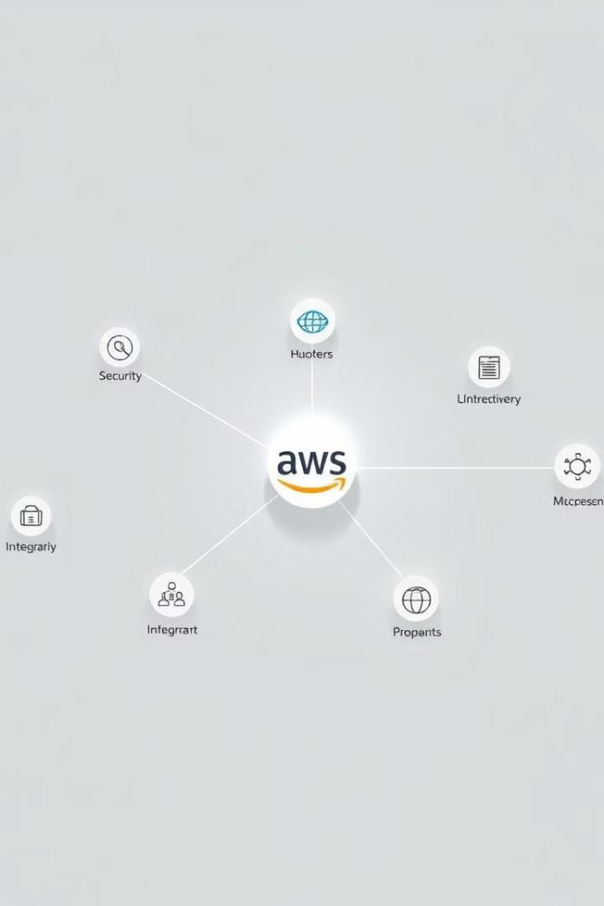
Partner
Integrations
1
Integrations with leading security information and event
management (SIEM) solutions.
2
Partnerships with leading security analytics platforms.
3
Integration with threat intelligence feeds and services.
p
reencoded.png

Slide 16


Getting Started with Amazon
Security Lake
Create a Security Lake
Launch a Security Lake service and configure data sources.
Define Data Schemas
Define the structure and organization of your security data.
Configure Data Ingestion
Set up data pipelines to collect and stream data into the lake.
Analyze and Visualize Data
Query and visualize security data using tools like Athena and QuickSight.
p
reencoded.png

Slide 17

Conclusion and Key
Takeaways
Amazon Security Lake is a powerful platform for centralized security data management. It offers key features and benefits that can enhance your security posture, improve threat detection, and streamline incident response. Consider adopting this service for simplified and efficient security data management.
reencoded.png
p

